Slide 1

Apple Stock Price Prediction for the Next 30 Days

Slide 2

Forecasting Apple Stock ​
Prices for the next 30 Days
This is a complete machine learning project focused on forecasting the next 30 days of Apple stock prices using historical data.
Presented By : Group 4
Course : Data Science
Date : 10/12/2025

Slide 3

Mentor and
Group Members
Mentor :
Ms.Sadhiya
Team Members :
Saileena Mohanty
Ushir Mrunmayi Pramodkumar
Steffi Shekinah.J
Sarthak Talkhandkar
Akansha Shinde
Nava Chaitanya Lekkala
Laya Bongoni

Slide 4

Why Stock Price
Prediction ?
Reduces investment risk
Helps trading & portfolio decisions
Supports financial planning

Slide 5

OBJECTIVE
The main objective of this project is to develop a forecasting model that predicts Apple’s stock prices for the upcoming 30 days using historical stock market data.
This prediction will help investors, analysts, and traders make more informed decisions by understanding future price trends and patterns.

Slide 6

Dataset Summary
The dataset contains Apple’s historical stock information from 2012–2019.
Key columns include:
  Date
  Open
  High
  Low
  Close (target variable)
  Adj Close
  Volume
Daily records make this dataset ideal for time series forecasting.

Slide 7

Steps In Model Building
Data Preprocessing
EDA
Feature Engineering
Model Training
Evaluation

Slide 8

Data Preprocessing
Handled missing values
Converted "Date" to datetime format
Sorting
Base transformation

Slide 9

Exploratory Data Analysis (EDA)

Slide 10
Key observations from this data :
Apple stock shows a strong upward trend from 2012 – 2019
Some seasonal patterns were observed around earning announcements
High trading volume is seen around Major product launches
Visualizing the time series helps understand long-term behaviour

Slide 11

Data Visualizations

Slide 12
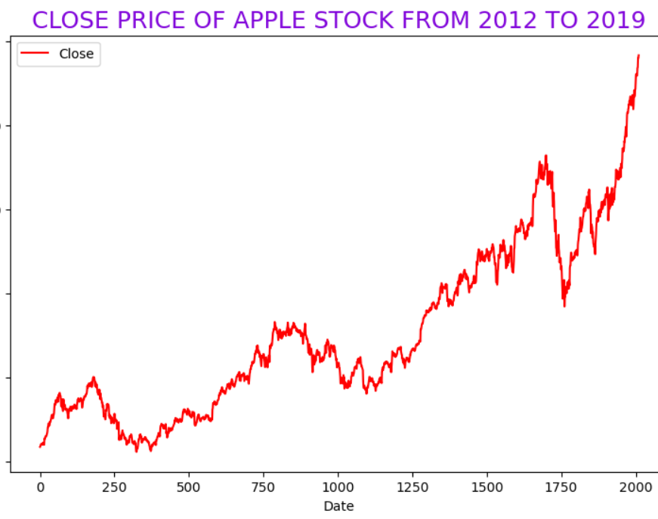
Apple Closing Price
Show historical price movement
Clear long-term upward trend
Short-term fluctuations indicate market volatility
Consistent long-term growth observed

Slide 13
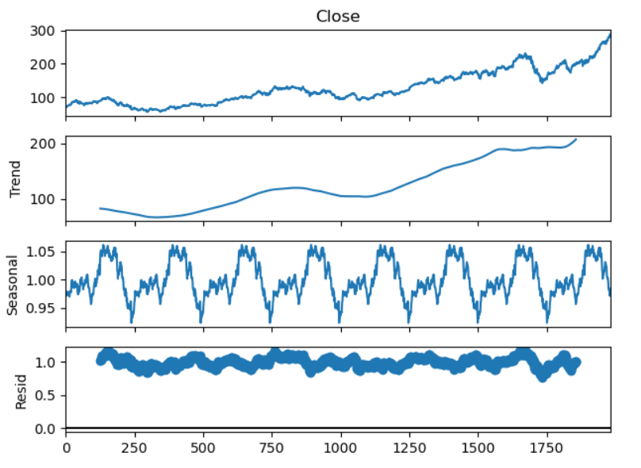
Time Series Decomposition
Key Points :
  Trend → long-term movement
  Seasonality → repeating pattern
  Residual → noise
Stock prices contain trend, seasonality, and noise

Slide 14
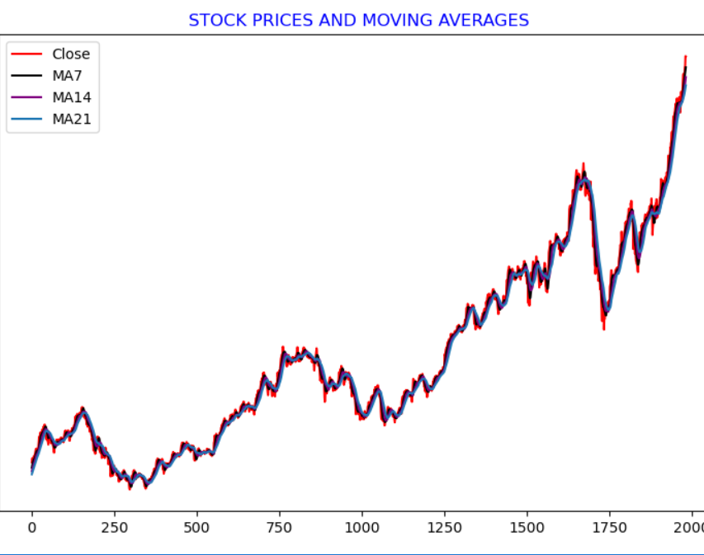
Moving Averages Analysis
Smooth price data and identify trends
Key Points :
  MA7 reacts quickly (short-term trends)
  MA14 & MA21 show stable long-term direction
Moving averages help reduce noise and detect trends

Slide 15
Feature Engineering
Lag Features: Close(t−1), Close(t−2), Close(t−3)
Moving Averages: MA7, MA14 , MA21
Time Features
Volatility: Standard deviation of last 7 days
Range: High − Low
These help the model learn past behavior

Slide 16
Introduction to Modeling
Models selected for forecasting include:
- ARIMA – Best suited for data with clear trend
- SARIMA – Captures seasonality and repeating patterns
- XGBoost – Machine learning model to learn complex, non-linear movements
Models were compared to determine which gives the most reliable predictions.
Stock price prediction requires analyzing historical patterns.

Slide 17
ARIMA Model Overview
ARIMA: Auto-Regressive Integrated Moving Average
Suitable for linear time-series data
Model used: ARIMA(5,1,2)
Selected using AIC criteria
Generated 30-day forecasts

Slide 18
Limitations of ARIMA
Works only on one-dimensional time series
Cannot use engineered features
Struggles with non-linear market patterns
Produced higher error values

Slide 19
SARIMA Model Overview
SARIMA: Seasonal Auto-Regressive Integrated Moving Average
Extension of ARIMA that handles seasonal patterns
Suitable for time-series data with:
  Trend
  Seasonality
Model structure: SARIMA(p,d,q)

Slide 20
Limitations of SARIMA
Requires manual identification of seasonal parameters
Works only on a single time-series variable
Cannot incorporate engineered features
Computationally more expensive than ARIMA
Still struggles with complex non-linear behavior

Slide 21
XGBoost Model Overview
Gradient Boosting algorithm
Handles non-linear relationships effectively
Uses engineered features for better accuracy
Parameters used:
  n_estimators = 300
  max_depth = 5
  learning_rate = 0.05

Slide 22
XGBoost Prediction Method
Uses recursive multi-step forecasting
For each future day:
  Uses previous predictions and features
  Produces smooth and stable 30-day forecasts

Slide 23
Model Evaluation Metrics
RMSE (Root Mean Squared Error)
MAE (Mean Absolute Error)
Lower values indicate better model performance
Metrics computed for ARIMA , SARIMA and XGBoost

Slide 24
Performance Comparison
Model | MAE | RMSE | Verdict
XGBoost Model | 21.4016 | 32.6839 | Most accurate
ARIMA | 66.3060 | 72.1603 | Moderate
SARIMA | 82.8458 | 86.8114 | Less Accurate

Slide 25
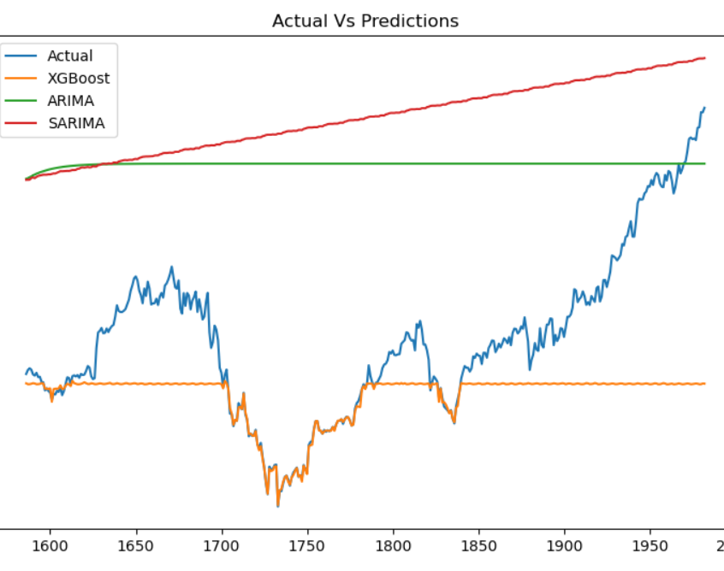
Actual Vs Predictions
Key Points :
  Actual prices show high volatility
  ML models (XGBoost) follow patterns better
  ARIMA & SARIMA are smoother and less reactive
ML models handle complex stock behavior better

Slide 26
Final Model Summary
Final Model Selected: XGBoost
Strengths:
  High predictive power
  Handles complex patterns
  Reliable 30-day forecasts
XGBoost outperformed ARIMA and SARIMA in all metrics
Final Streamlit deployment uses XGBoost
End-to-end ML workflow successfully implemented

Slide 27
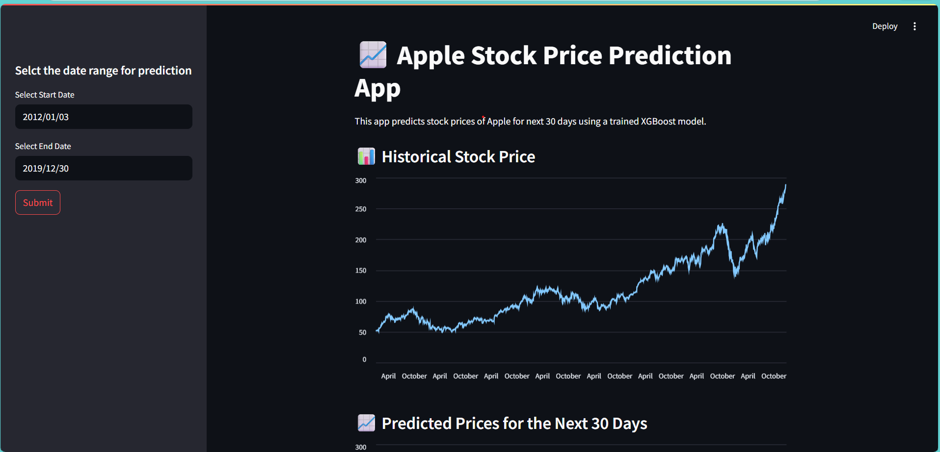
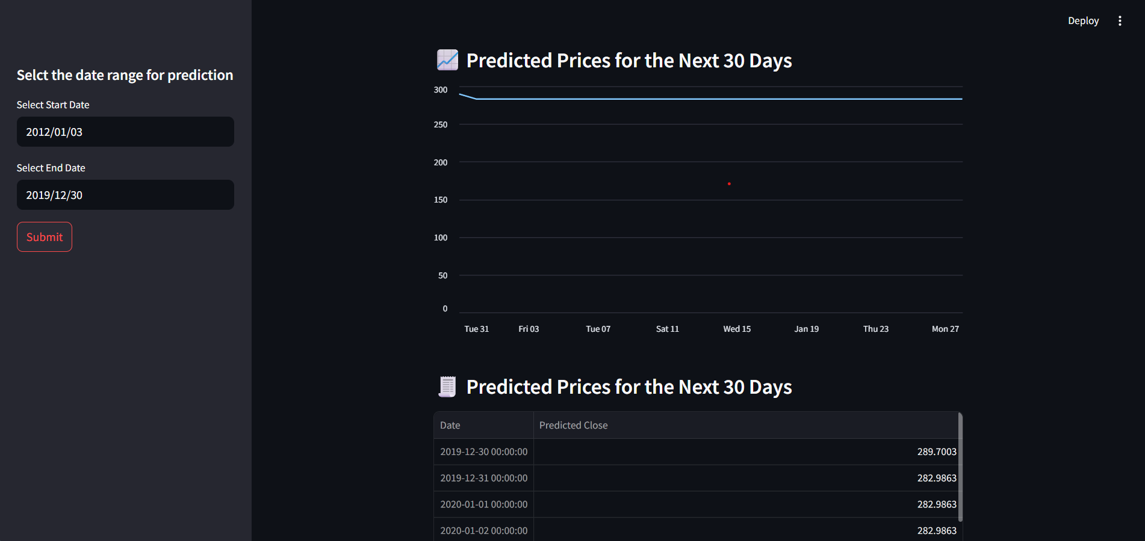
Deployed Model

Slide 28
Challenges Faced During the Project
Data cleaning issues :
- missing, duplicate, or inconsistent records that affect model quality.
Model overfitting :
- model performs well on training data but poorly on unseen data.
Feature engineering complexity :
- creating reliable, informative features from raw stock data is challenging.
Scaling problems :
- differences in feature scale and distribution can hurt model training and interpretability.

Slide 29
THANK YOU

